Slide 1
Hardware Fundamentals
Notes:
This template can be used as a starter file for presenting training materials in a group setting.
Sections
Right-click on a slide to add sections. Sections can help to organize your slides or facilitate collaboration between multiple authors.
Notes
Use the Notes section for delivery notes or to provide additional details for the audience. View these notes in Presentation View during your presentation.
Keep in mind the font size (important for accessibility, visibility, videotaping, and online production)
Coordinated colors
Pay particular attention to the graphs, charts, and text boxes.
Consider that attendees will print in black and white or grayscale. Run a test print to make sure your colors work when printed in pure black and white and grayscale.
Graphics, tables, and graphs
Keep it simple: If possible, use consistent, non-distracting styles and colors.
Label all graphs and tables.

Slide 2
Computer
A computer is a programmable electronic device designed to accept data, perform prescribed mathematical and logical operations at high speed, and display the results of these operations, all under the control of software.

Slide 3
Hardware:
Computer Hardware refers to the physical parts of a computer and related devices.
Internal hardware devices include motherboards, hard drives and RAM.
External hardware devices include monitors, keyboards, Mice, printers and scanners.
Notes:
Give a brief overview of the presentation. Describe the major focus of the presentation and why it is important.
Introduce each of the major topics.
To provide a road map for the audience, you can repeat this Overview slide throughout the presentation, highlighting the particular topic you will discuss next.

Slide 4
Software
Software is a set of instructions and associated documentation that tells a computer what to do or how to perform a task or it can mean all the software on a computer, including the applications and the operating system.

Slide 5
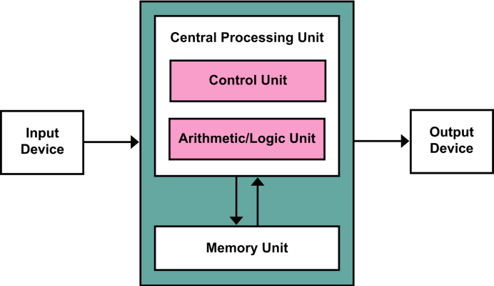
Block diagram of Computer

Slide 6

Input Devices:
An input device is any hardware component that allows you to enter data and instructions onto a computer.
Widely used input devices are the keyboard, mouse, scanner.
Notes:
This is another option for an Overview slides using transitions.

Slide 7
Keyboard:
Keyboard connector types
1. DIN
2. USB
3. PS/2 (5 or 6 pins)
DIN type is a 5 pin connector.
USB type is hot swappable.
Compatible port for PS/2- purple or violet.
Standard Keyboard keys- 102.

Slide 8

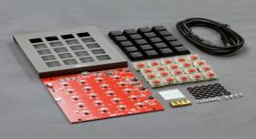
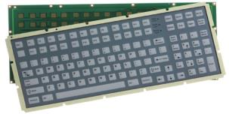
Keyboard
Mechanical Keyboard
Membrane keyboard

Slide 9

Mouse:
A Computer Mouse is a handheld hardware input device that controls a cursor in a GUI and can move and select text, icons, files, and folders.
Functions of a mouse:
1. Move the cursor
2. Open or execute program
3. Select
4. Drag-and-Drop
5. Hover
6. Scroll
7. Perform other functions etc.

Slide 10
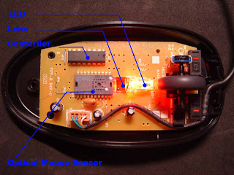
Working of Optical Mouse:

Slide 11
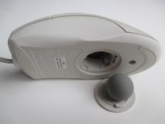
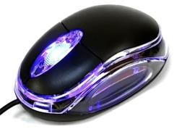
Types of Mouse
Ball Mouse
Optical Mouse

Slide 12
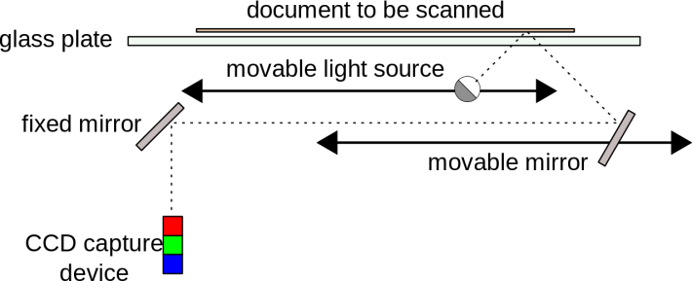
Scanner
Scanner is a device that capture images from photographic prints, posters, documents for computer editing and display.
Working Principle:

Slide 13
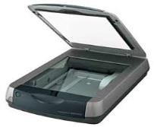



Types of Scanners
Flatbed scanner
Handheld Scanner
Sheet fed Scanner
Drum Scanner

Slide 14
Output Devices:
An output device is any device used to send data from a computer to another device or user.
Most computer data output that is meant for humans is in the form of audio or video. Thus, most output devices used by humans are in these categories.
Examples include monitors, projectors, speakers, headphones and printers.

Slide 15
Monitors:
A computer monitor is an output device which displays information in pictorial form.
Types of Monitors
CRT Monitors
LCD Monitors
LED Monitors

Slide 16
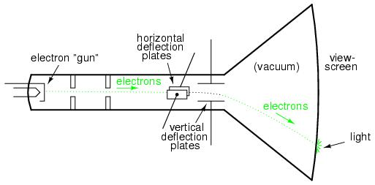
CRT(Cathode Ray Tube) Monitors:
Phosphor coated screen

Slide 17
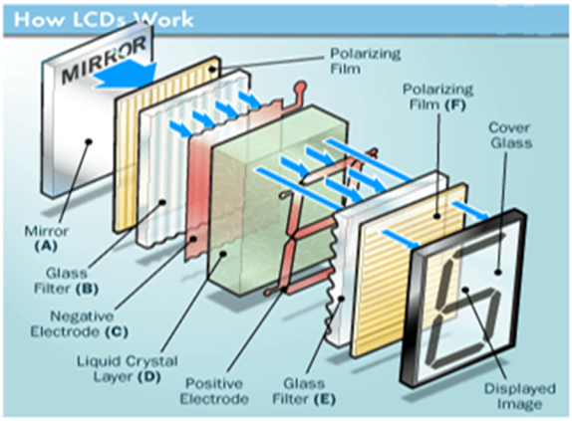
LCD Monitors:

Slide 18
Printers:
A Printer is an output device which provides output in the form of a hardcopy.
In general, more expensive printers are used for higher-resolution color printing.
Types of printers:
Impact printers.
Dot matrix printers
Non-impact printers.
Ink-Jet printers.
LASER Printers.

Slide 19
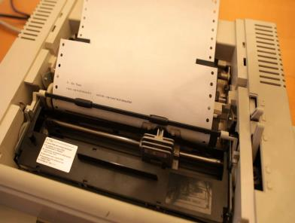
Dot Matrix printers:
Dot matrix printers is like a typewriter which uses striking mechanism.
Each individual character is formed by the arrangement of a series of pins.
It gives the printout in a characteristic “dotted” appearance.

Slide 20
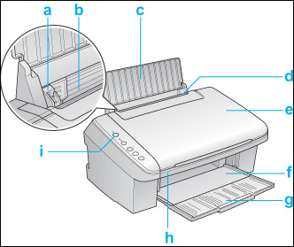
COMPONENTS OF INKJET PRINTERS
A. Edge guide-: It helps to keep paper straight.
There is a little adjustment in the left edge
guide roller so that it fits to width of paper.
B. Sheet feeder-: It helps to feed paper in
printer automatically.
C. Paper support-: it gives supports to the
paper to load in sheet feeder parts.
D. Feeder guard-: Feeder guard prevents
objects placed on the document cover from
falling inside the printer while opening the
docs cover.
E. Document cover-: Open and close when you place a photo or document.
F. Output tray-: Output tray collect and receive all printed paper.
G. Output tray extension-: Supports while the paper ejected.
H. Scanner unit-: Helps to take photo copy.
Power Button

Slide 21
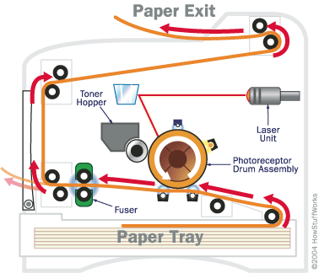
Laser Printer:
It’s a non-impact printer which uses photocopier technology for printing.
LASER printer was invented by Gary StarkWeather.
LASER printer is able to print in different colors.

Slide 22
Processor
It is a computer processor on a microchip and is a multipurpose, programmable device that uses digital data as input and provides results as an output once it processes the input according to instructions stored in its memory.

Slide 23

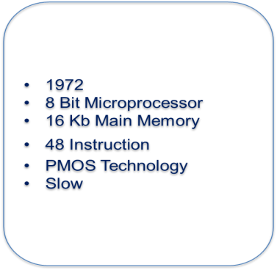
Intel 4004
1971
4 Bit Microprocessor
4kb Main Memory
45 Instruction
PMOS Technology
First Programmable Device In Calculators

Slide 24

Intel 8080
1973
8 Bit Microprocessor
64kb Main Memory
Two Microprocessor Clock Cycle Time
500000 Instruction Per Second
10x Faster Then 8008
Nmos Technology
Drawback Was That It Need Three Power Supplies
Small Computer Were Designed In Mid 1970 Using 8080 Cpu
1975
8 Bit Microprocessor
64kb Main Memory
1.3 Microprocessor Clock Cycle Time
246 Instruction
Intel Sold 100 Million Copies Of 8 Bit
Uses Only +5v Power Supply

Slide 25
Intel 8086/8088
Intel 80186
1978 for 8086 ,1979 for 8088
16 Bit Microprocessor
Data bus with 8086 16Bit and 8Bit for 8088
1 MB Main memory
400 Nano second clock cycle time
6 bytes instruction for 8086 and 4 bytes for 8088
More register and additional instruction
1981 personal computer for IBM
1982
16 Bit Microprocessor
1 MB Main memory
Contained special hardware like program counter and interrupt controller
Never used in PC
But was ideal for system that required a minimum of hardware

Slide 26
Intel 80286
Intel 80386
1983
16 Bit high performance microprocessor with memory management and protection
16 MB Main memory
Few additional instruction to handle extra 15MB
Instruction execution time 250 Nano second
Multitasking
1986
Intel first 32 bit
4 GB Main memory
Improvements include page handling in virtual environment
Includes hardware circuity for memory management and memory assignment
Memory paging and enhanced I/O permission

Slide 27
Intel 80486
Pentium
1989
32 bit high performance
4 GB Main memory
Incorporates 80387 floating point microprocessor and 8k byte cache
About half of instruction executed in 1 clock cycle instead of 20 n 80386
1993
32 bit microprocessor, 64 bit data bus, 36 bit address bus
64 GB Main memory
Double clocked 120 and 133 MHZ, dual integer processor
16 KB L1 cache (split instruction and data 8 KB each)

Slide 28
Pentium Pro
Pentium III
1997
32 bit microprocessor, 64 bit data bus, 36 bit address bus, MMX
64 GB Main memory
32 KB split instruction / data L1 cache(16 KB each)
Module integrated 512 KB L2 cache(133 MHZ)
A version of P2 called Xeon, specifically designed for high end application
1999
32 bit microprocessor, 64 bit data bus, 36 bit address bus
64 GB Main memory
Dual independent bus/ simultaneous
On chip 316

Slide 29
Pentium IV
2002
32 bit microprocessor, 64 bit data bus, 36 bit address bus
64 GB Main memory

Slide 30
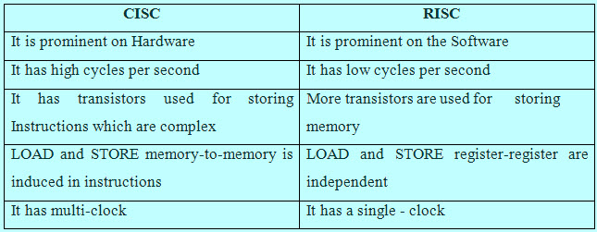
CISC vs RISC

Slide 31
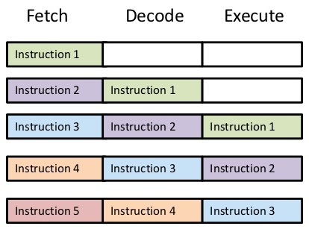

Slide 32
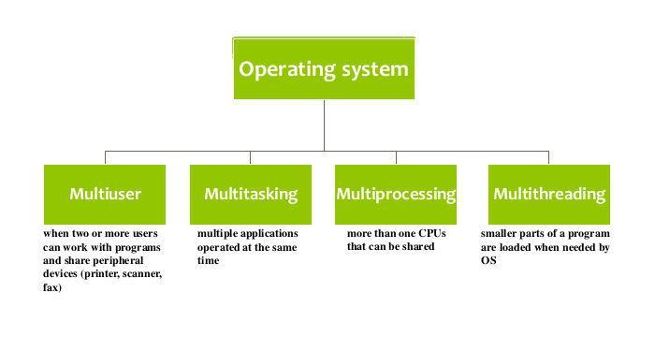

Slide 33
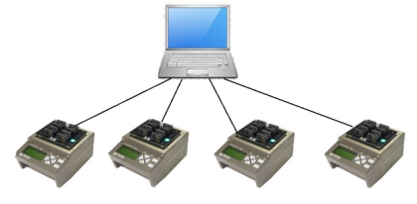
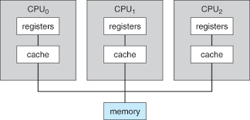
Multiprogramming :
Multiprogramming is a rudimentary form of parallel processing in which several programs are run at the same time on a uniprocessor.
The operating system executes part of one program, then part of another, and so on.
To the user it appears that all programs
are executing at the same time.
Multiprocessing :
Multiprocessing is the coordinated processing of programs by more than one computer processor.
Multiprocessing is a general term that can mean the dynamic assignment of a program to one of two or more computers working in tandem or can involve multiple computers working on the same program at the same time (in parallel).

Slide 34
Multitasking :
Multitasking, in an operating system, is allowing a user to perform more than one computer task (such as the operation of an application program) at a time.
The operating system is able to keep track of where you are in these tasks and go from one to the other without losing information.
Multithreading:
Multithreading is a type of execution model that allows multiple threads to exist within the context of a process such that they execute independently but share their process resources.
Multithreading is similar to multitasking, but enables the processing of multiple threads at one time, rather than multiple processes.
Since threads are smaller, more basic instructions than processes, multithreading may occur within processes.

Slide 35
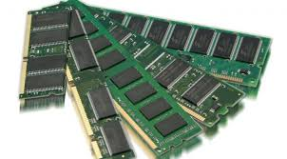
MEMORY
Memory refers to the computer hardware integrated circuits that store information for immediate use in a computer.
For example, Random Access Memory (RAM), is a volatile memory that stores information on an integrated circuit used by the operating system, software, and hardware.

Slide 36
TYPES
Primary memory
RAM(Random Access Memory): Ram is a type of data storage used in computers that is generally located on the motherboard.
SRAM(Static Random Access Memory): It is a type of RAM that holds data in static form.
DRAM(Dynamic Random Access Memory): It is a type of memory that is used for data or program code that a computer programmer needs the function.

Slide 37
ROM(Read Only Memory) : Is a type of non-volatile memory used in computers and other electronic devices. Data stored in ROM can only be modified slowly, with difficulty, or not at all so it is mainly used to store data.
PROM(Programmable Read Only memory) : Are used in digital electronic devices to store permanent data, usually low level programs such as firmware.
EPROM(Erasable Programmable Read Only memory):Is a type of memory chip that retains its data when its power supply is switched off.
EEPROM(Electrically Erasable Programmable Read Only Memory): Is a type of memory used in computers and other electronic devices to store relatively small amounts of data but allowing individual bytes to be erased and reprogrammed.

Slide 38
Types of DDR RAMs:
DDR1:
DDR has a memory clock speed of at least 200MHz.
The DDR module uses a 184-pin connector‘.
DDR2:
DDR has a memory clock speed of at least 400MHz.
The DDR module uses a 240-pin connector'.
DDR3:
DDR has a memory clock speed of at least 666MHz.
The DDR module uses a 240-pin connector'.

Slide 39
Cache Memory:
Cache Memory is fast memory that serves as a buffer between the processor and main memory.
The cache holds data that was recently used by the processor and saves a trip all the way back to slower main memory.
Levels of Cache Memory:
L1 cache First level of cache usually contained in processor
L2 cache Second level of cache contained on Motherboard
L3 cache Processors include L1 and L2 cache on the chip, it becomes L3 cache. Usually, it runs slower than the processor, but faster than main memory.

Slide 40
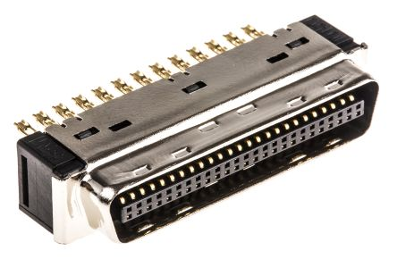
SCSI:
SCSI is an acronym for “Small Computer Systems Interface”
A small computer systems interface (SCSI) is a standard interface for connecting peripheral devices to a PC.
Depending on the standard, generally it can connect up to 16 peripheral devices using a single bus including one host adapter.
SCSI is used to increase performance, deliver faster
data transfer and provide larger
expansion for devices such as CD-ROM
drives, scanners , DVD drives and
CD writers.

Slide 41
Motherboard
A motherboard is the main circuit board inside a computer that connects the different parts of a computer together directly or indirectly.
It has sockets for the CPU, RAM and expansion cards and it also hooks up to hard drives, disc drives and front panel ports with cables and wires.

Slide 42
Functions of Motherboard:
The motherboard acts as the central backbone of a computer on which other modular parts are installed such as the CPU, RAM and hard disks.
The motherboard also acts as the platform on which various expansion slots are available to install other devices.
The motherboard is also responsible to distribute power to the various components of the computer.

Slide 43
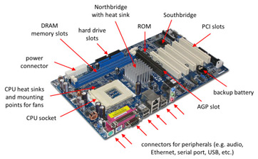
Motherboard Components and Connectors
Processor :
A processor is a logic circuitry that responds to and processes the basic instructions that drive a computer.
The four primary functions of a processor are Fetch, Decode, Execute and Display.

Slide 44
PCI SLOT (Peripheral Component Interconnect) : PCI slots are used to Insert or install Add-on cards, such as LAN cards, Sound cards, Capture cards and TV tuner cards. There are usually anywhere from 1 to 6 PCI slots available on the motherboard(above board has 2 PCI slots. ), they have decreased in number and are being replaced by the PCI Express 1x slots.
Northbridge: This allows communication between the CPU and the system memory and PCI-E slots.
Southbridge: This is the controller for components such as the PCI slots, onboard audio, and USB connections.

Slide 45
SATA Connections : SATA full form is Serial Advanced Technology Attachment. These are connected with serial ATA devices, such as Hard disk drives and CD or DVD drives.
ATX Power Connector: This is the second of two power connections. This is the main power connection for the motherboard, and comes from the Power Supply.
DIMM slots: DIMM's are by far and away the most used memory types in today's computers. They vary in speeds and standards however and they need to match up to what your motherboard has been designed to take. The four standards of DIMM's being used at the moment are SDR (Single Data Rate), DDR (Double Data Rate), DDR2 and DDR3. The speeds of memory can vary between 66Mhz to 1600Mhz .

Slide 46
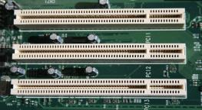
ISA (Industry Standard Architecture:(16 bit)
It allows 16 bits data at a time to flow between the Motherboard circuitry and expansion slot card
EISA ( Extended Industry Standard Architecture-32bit)
CNR: Communications and network Riser is used for networking, audio and telephone equipment. It has two rows of 30 pins.

Slide 47
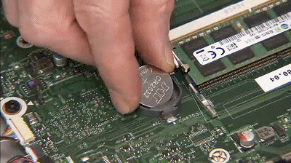
CMOS battery:
“Complimentary metal-oxide semiconductor”. It is an onboard, battery powered semiconductor chip inside computers that stores Bios settings.

Slide 48
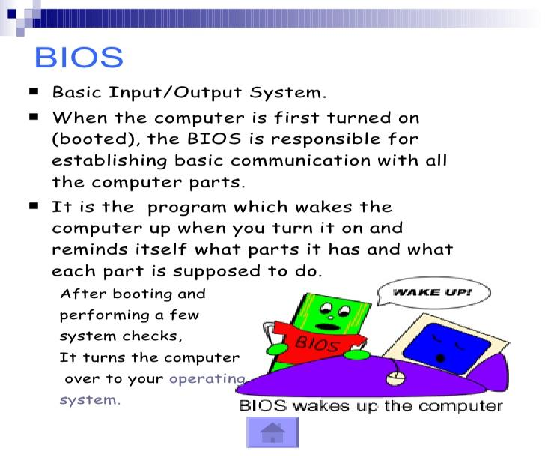

Slide 49
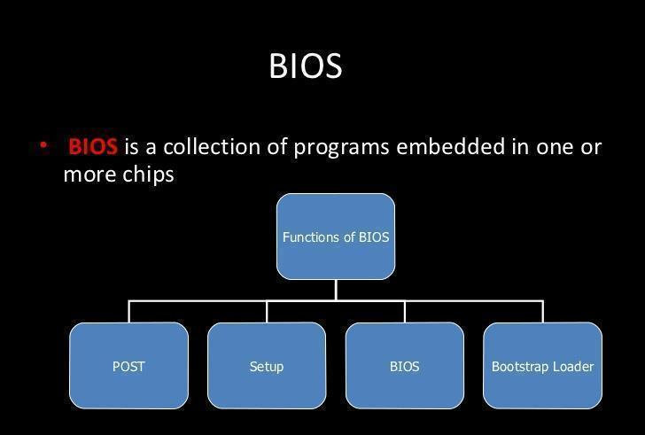

Slide 50
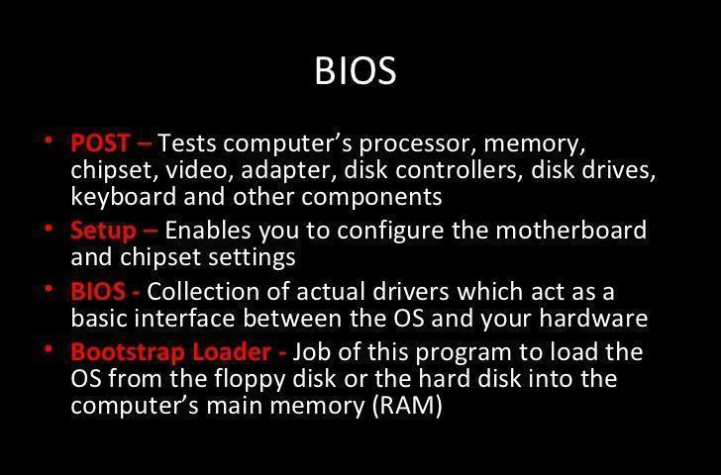

Slide 51

SMPS (Switch Mode Power Supply):
The electronic power supply integrated with the switching regulator for converting the electrical power efficiently from one form to another form with desired characteristics is called as Switch-mode power supply. It is used to obtain regulated DC output voltage from unregulated AC or DC input voltage.

Slide 52
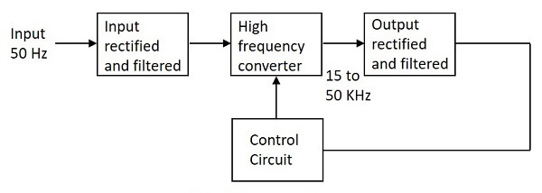
Block Diagram of SMPS:

Slide 53
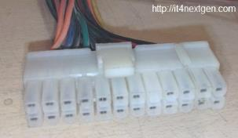
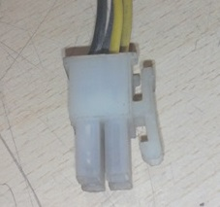
Connectors of SMPS:
ATX connector:
It is a 24-pin female connector which is used to supply DC supply to the motherboards.
ATX-12V connector: Latest SMPS power supplies are accompanied by an extra 4-pin connector which supplies 12 volts to energize
the central processing unit and other
components of the motherboard.

Slide 54
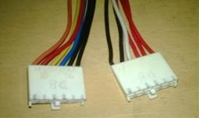
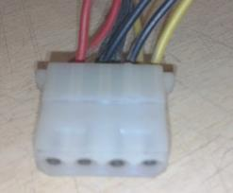
AT Connectors:
Earlier motherboards used to support AT connectors
( 6-pin each) also called P8 and P9 connectors to
supply power to these motherboards.
4 pin Connectors:
There are multiple 4-pin connectors that draw out from the SPMS unit. These connectors are used to supply DC power to various peripherals of computer like a floppy disk drive, hard disk drive or DVD-writers.

Slide 55
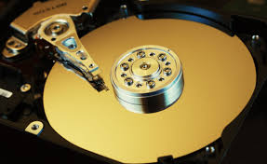
HARD DISK

Slide 56
HardDisk
A hard disk drive (HDD), hard disk, is a data storage device that uses magnetic storage to store and retrieve digital information using one or more rapidly rotating disks.
Introduced by IBM in 1956
Secondary storage device for general purpose computers.

Slide 57
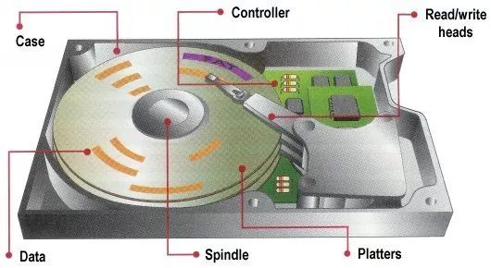
Components of a Hard disk

